Slide 1
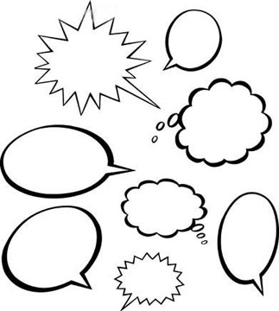
Sound
Some from Heim Chap 13
Prepared By Beryl Plimmer 2011
The sound files are not linked – most should work on windows 7 machines

Slide 2
Sound versus Visual
Sound exists in time and over space, vision exists in space and over time.
(Gaver, 1989)
Sound is only there when it is playing/made
Vision is there until it is replaced

Slide 3
Sound Interaction
Computer Output/Generation (Human Input)
Non speech
Music
Audio Icons and Earcons
Speech
Computer Recognition
Speech
Non speech
Environmental
Music
3

Slide 4
Computer Output: Music
Can be pre-recorded or generated
Movies
Games
Immersive experiences

Slide 5
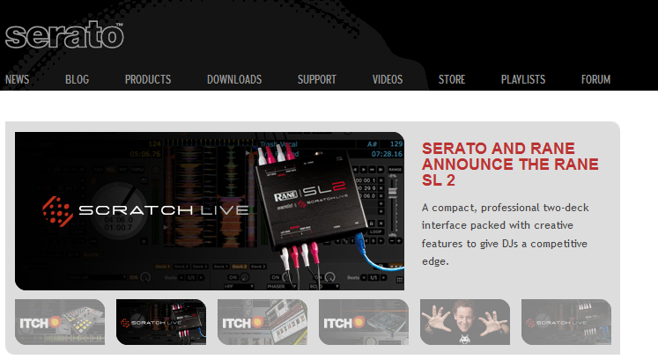
Generating music
Exciting area for artists
Everything from pseudo real to completely abstract
There are Jazz music generators that only skilled people can differentiate from actual musicians.
Serato – dj software (www.serato.com)
Auckland company doing fantastic things
Several UOA grads there

Slide 6
Auditory Icons and Earcons
The difference between these two is subtle
‘Natural’ sounds
‘Artificial’ sounds (generated)
Windows hardware fail insert remove

Slide 7
Auditory Icons and Earcons
Redundant Encoding
It aids memory by adding additional associations.
Can alert without interrupting
An alterative communications channel.
Positive/Negative Feedback
Auditory alarms might be crucial to the safe operation of computer-operated machinery or mission-critical environments
Too many alarms
Annoying
Ignored

Slide 8
Using Sound in Interaction Design
Learnability of the mapping between the icon and the object represented
“Oink” and “bow wow” have high articulatory directness
A swishing sound accompanying a paintbrush tool also has high articulatory directness
A system beep carries is an abstract representation

Slide 9
Innate human understanding
Volume
<quiet -------------------------------------------------------------------loud>
Whisper
Shout
Pitch
Baby crying
Reassurance
Authoritative
Rhythm
Urgency
Mood
Length
Start, stop, duration

Slide 10
Can you remember earcons?
How many?
How often do you hear them?
Can you intuitively tell what these mean?
On
Off
Sleep
Mis-recognized
Dis-ambiguate

Slide 11
Speech Output
Eyes free operation
Alternative output channel
Good for checking your essays
Navigation is hard
Back tracking,
finding location of particular thing

Slide 12
Speech Output
Recorded
Menu choices for telephone systems
Books or other multimedia experiences
Generated
Good voice synthesisers built in to op systems
Windows navigator
Can give pronunciation rules
Still sound a little artificial

Slide 13
Sound Input
Speech
Environmental
Music

Slide 14
Speech Recognition
Two distinct applications:
Transaction
Transcription
Transaction
Telephone menu systems
Choose from a limited number of options, works ok
Automatic speech recognition (ASR)
Built into operating systems
Dragon Systems’ NaturallySpeaking® and IBM’s Via Voice®
Error prone!
Very difficult, ongoing research problem

Slide 15
Searching Speech and Audio
Sound files do not afford easy opportunities for indexing and searching
Speech translation can be used to transcribe speech files and create transcripts that can be searched like any other text file
So long as recognition accuracy is ok, which it isn't at the moment
Tune identification apps
hum a bit of the tune and it tells you what it is!
Easier than translation

Slide 16
Summary
Sound is transitory
Sound output
Non speech
Music
Earcons
Speech
Sound recognition
Speech
Transaction
Transcription
Error prone
Sound is more complex than colour/light

